Slide 1



ML DRIVEN HARDWARE
Differential amplifier
By Sajja Patel
& Pavan Pachava

Slide 2
AMPLIFIER OR differential amplifier? Why?
Amplifier: an amplifier is a device that accepts the input signal and produces an output signal proportional to the input.
Differential amplifier: an amplifier that amplifies the difference between two signals is called a differential amplifier.
ADVANTAGES OF DIFFERENTIAL AMPLIFIER-
Excellent stability
Immune to noise and interference signals.
Used in most of the analog circuits ranging from dc to high-frequency applications.

Slide 3
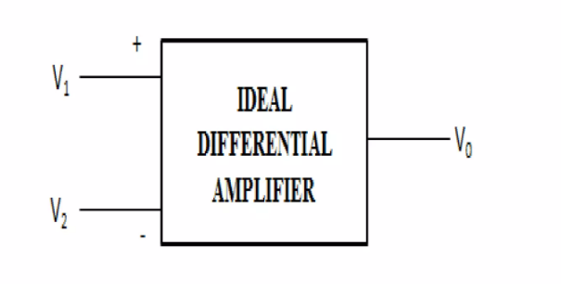
What is a differential amplifier?
When two inputs are applied at the two terminals the voltage difference produced resultantly will be proportional to the difference of the two applied input signals. A differential amplifier behaves as a subtractor circuit, that basically subtracts the two input signals.
The differential amplifier can be constructed by making use of BJTs and FETs

Slide 4
Basic implementation
We have build a differential amplifier.
We built the entire differential amplifier circuit with the help of a software named- MicroCap.
After that we took readings for variation of output voltage according to input and different temperatures and amplitude.
we will make an ML model on this data using an appropriate algorithm.

Slide 5
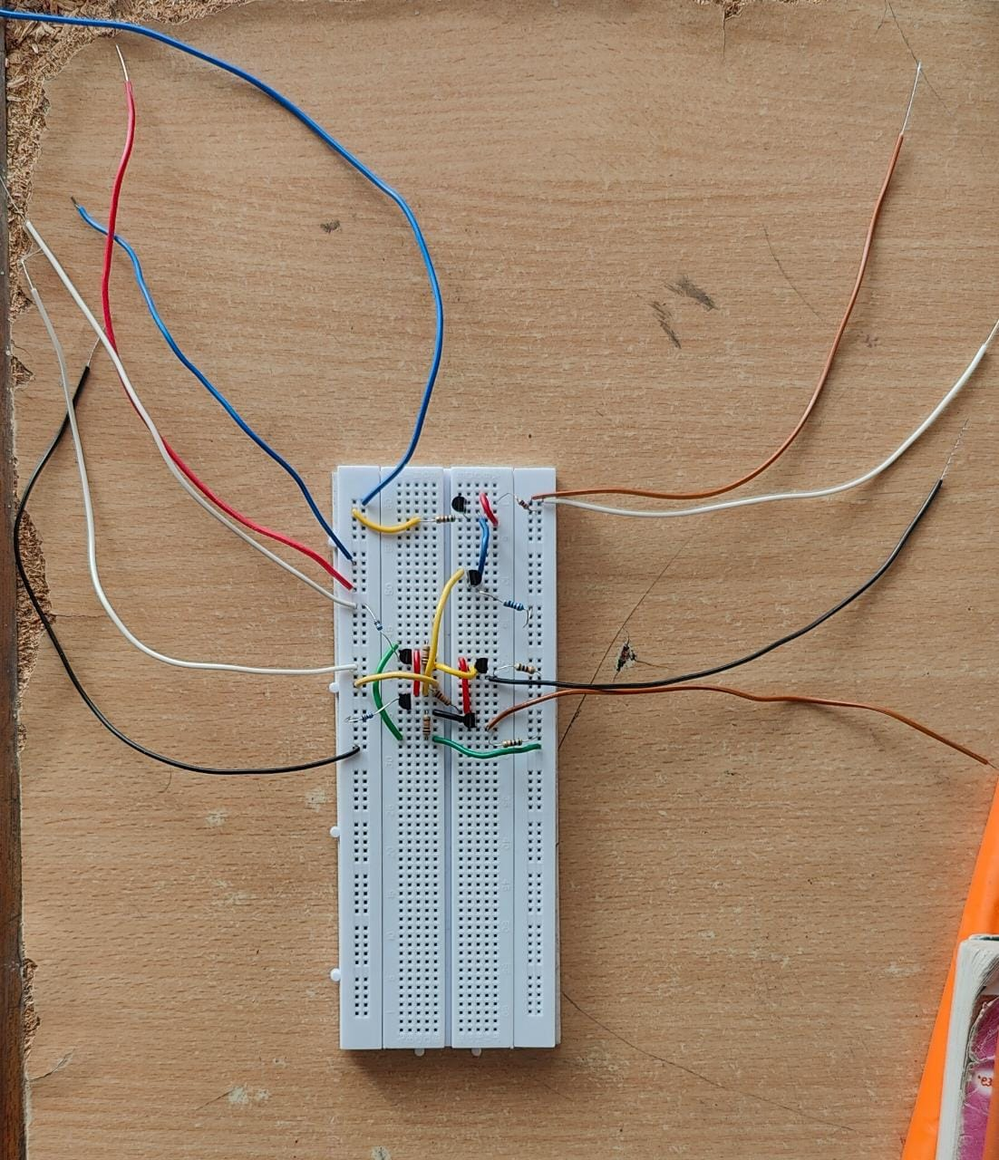
Basic implementation

Slide 6
Circuit design (micro-CAP)

Slide 7
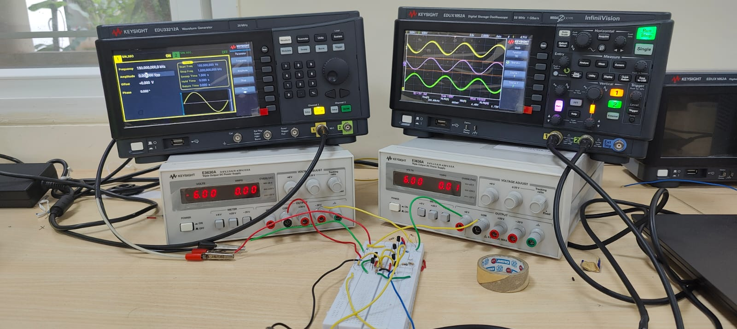
Hardware implementation

Slide 8
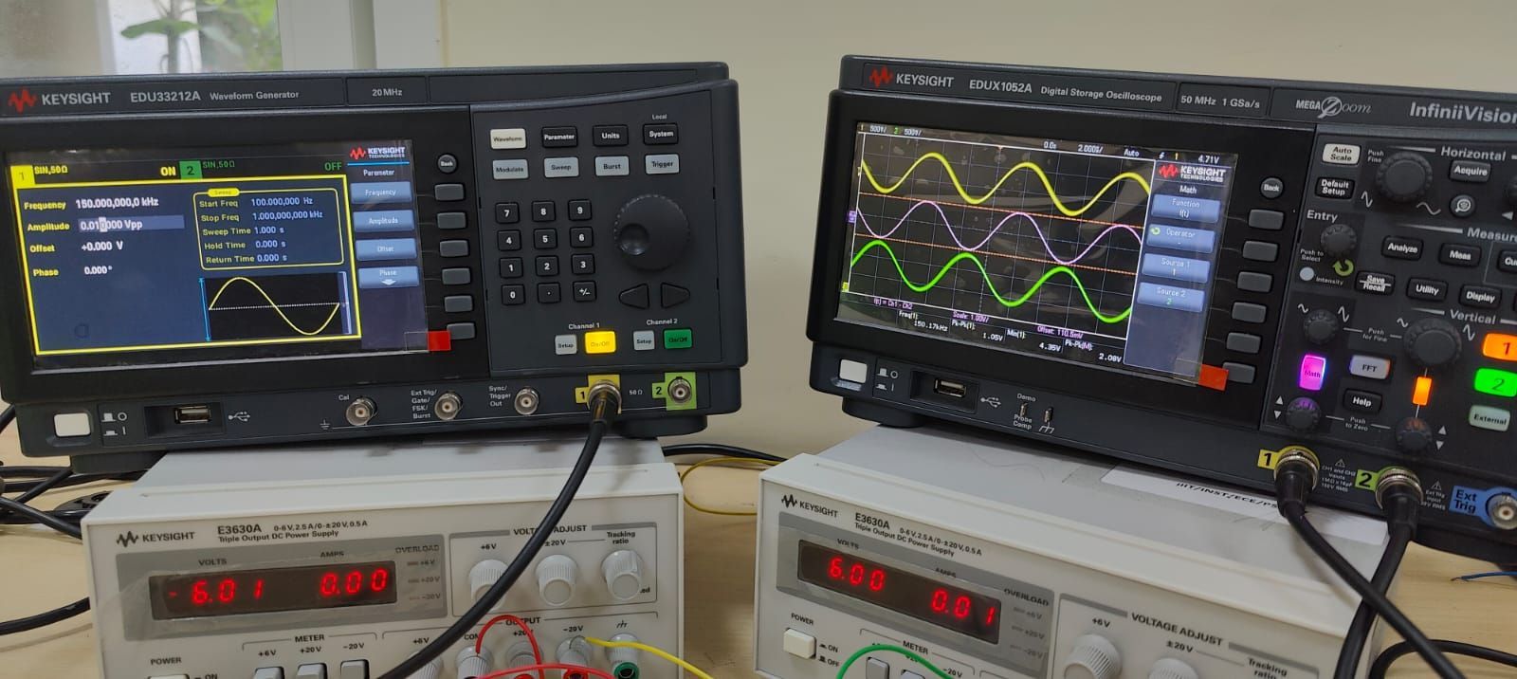
Hardware implementation

Slide 9
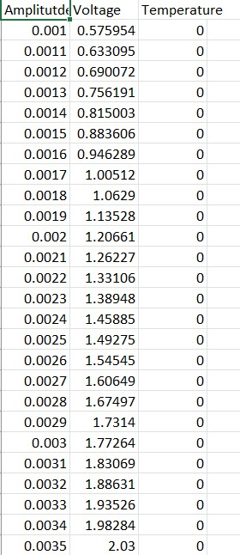
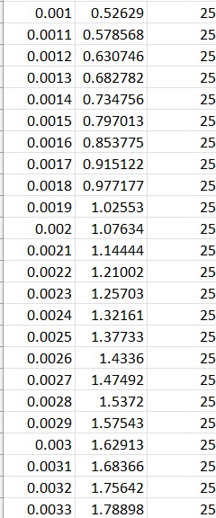
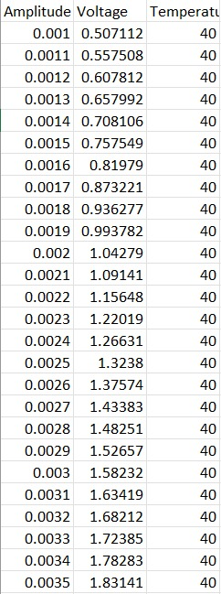
Observations/readings
We varied temperature and amplitude over a range of 0-40 deg Celcius and 0.001-0.006m respectively and obtained multiple data sets.(given below)

Slide 10
Contribution
SAJJA
hardware
presentation
Pavan
Microcap portion
presentation

Slide 11
THANK YOU!

